Slide 1

CMR Technical Campus Department of CSE
Industrial Oriented Mini Project
Project Title: AI Eval: AI Driven Evaluation for Enhanced Education Using Machine Learning
Project Supervisor:​
Name:​ G. Swathi
Designation: Associate Professer
Presented By:​
Batch No: 23
H. No: 227R1A05J8 Name: T. Vaishnavi
H. No: 227R1A05G7 Name: P. Vishali​
H. No: 237R5A0520 Name: K. Shiva Krishna
H. No: 227R1A05C9 Name: Aaryan Gade
​

Slide 2
Index
Department Vision and Mission
Abstract
Existing System
Disadvantage
Proposed system.
Advantages
Hardware and software requirements
Novelty of your Project
Architecture
Modules
UML Diagram
Sample Code
Result
Conclusion
Future Scope
References

Slide 3
DEPARTMENT VISION:
To provide quality education and a conducive learning environment in computer
engineering that foster critical thinking, creativity, and practical problem-solving
Skills.
DEPARTMENT MISSION:
1. To educate the students in fundamental principles of computing and induce the
skills needed to solve practical problems.
2. To provide State-of-the-art computing laboratory facilities to promote industry
institute interaction to enhance student’s practical knowledge.
3. To inculcate self-learning abilities, team spirit, and professional ethics among the
students to serve society.

Slide 4
ABSTRACT:
1. Technology has transformed the education system, making learning more engaging and informative.
2. However, the evaluation process remains traditional, relying on manual correction of exam papers by teachers.
3. Machine learning and Artificial Intelligence (AI) can automate grading, reducing errors and inconvenience.
4. AI-driven evaluation systems provide personalized feedback, analyze student responses, and predict academic performance.
5. These systems offer advantages like efficiency and scalability but also raise concerns about algorithmic bias and data privacy.
6. The proposed project aims to develop an AI-based educational evaluation system, exploring its hardware and software requirements.

Slide 5
Existing System
Accuracy
• Measures proportion of correctly classified instances.
• Evaluates overall model performance.
• Provides a general idea of model accuracy.
Precision
• Measures true positives among all positive predictions.
• Evaluates model's ability to avoid false positives.
• Provides insight into model's precision.
Recall
• Measures true positives among all actual positive instances
• Evaluates model's ability to detect true positives.
• Provides insight into model's recall.
Unsupervised Learning
• Trains models on unlabeled data.
• Discovers hidden patterns and relationships.
• Enables clustering, dimensionality reduction, and anomaly detection.

Slide 6
Disadvantage
Lack of Human Judgment – AI cannot fully understand creative or emotional aspects of student responses.
• Privacy Concerns – Student data security and compliance with regulations (GDPR, FERPA).
• Dependence on Internet & Technology – Requires strong infrastructure, limiting access in rural areas.

Slide 7
Proposed System
Data Plagiarism Detection
• Implement a plagiarism detection tool that allows users to make changes to their submissions with a 50% similarity threshold.
• This feature will encourage original work while providing flexibility for users to build upon existing ideas.
Reference File Submission
• Allow users to submit reference files to the bot, making it easier for the bot to evaluate the submission.
• This feature will enable the bot to better understand the context and content of the submission.
Efficiency Rate Evaluation
• Develop an efficiency rate metric to evaluate the effectiveness of the evaluation process.
• This metric will help identify areas for improvement and optimize the evaluation process.
Enhanced Data Security
• Implement robust security measures to protect the data, including encryption, access controls, and secure storage.
• This feature will safeguard the integrity and confidentiality of the data, ensuring a secure evaluation process

Slide 8
Advantages
• Automated Grading – Saves educators’ time and ensures consistency.
• Personalized Learning – Adapts to student strengths and weaknesses.
• Real-Time Feedback – Improves student engagement and comprehension.
• Scalability – Can handle large volumes of students efficiently.

Slide 9
REQUIREMENT ANALYSIS:
Hardware Requirements:
Processor- i5 or above
RAM: 8GB
Storage:20GB
Software Requirements:
Operating System: Windows 11 or above
Programming language:
Frontend: HTML, CSS
Backend: Java Script, PHP, Python
Code Editor: Visual Studio Code
Web Development: PyCharm
Database: PHPMyAdmin
Local Server: XAMPP

Slide 10
Novelty of project
The proposed AI-based educational evaluation system introduces a hybrid approach combining plagiarism detection with threshold tolerance, reference-aware assessment, and real-time feedback generation using intelligent algorithms.
Unlike conventional AI graders, this system includes customizable evaluation settings (e.g., similarity limits), enhanced data security mechanisms, and support for instructor-specific key files to personalize and contextualize assessment.
This multifaceted design improves fairness, encourages creativity, and ensures adaptability across varied educational environments.

Slide 11
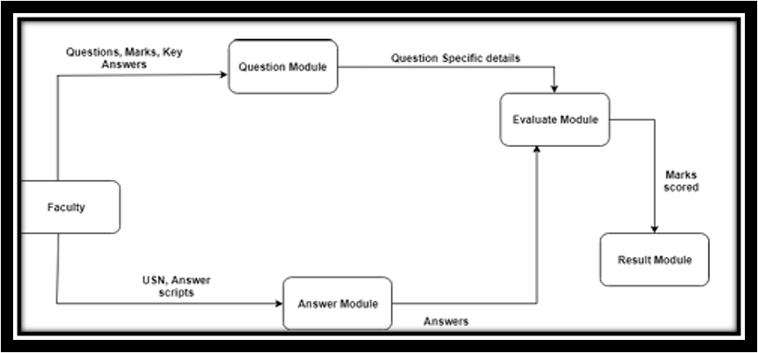
Architecture

Slide 12
Modules
User Authentication Module
Instructor login with avatar selection
Session management
Script Submission Module
Upload of student answer scripts
Reference file upload option
Plagiarism Detection Module
50% similarity threshold check using NLP
Evaluation Module
Score assignment based on key scripts
Efficiency rate metric generation
Feedback System
Real-time feedback to users
Data Security Module
Data encryption, secure storage, and access control

Slide 13
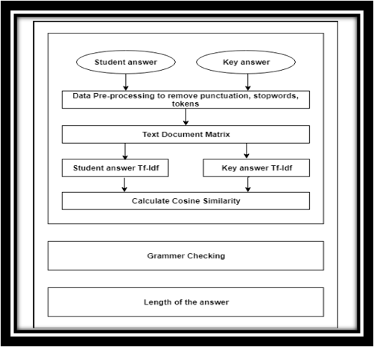
UML Diagrams

Slide 14
Sample Code
def PreprocessingTheSentence(stmt1):
stmt1=stmt1.lower()
import string CMRTC
remove=dict.fromkeys(map(ord,'\n'+string.punctuation)," ")
PSA1=stmt1.translate(remove)
word_tokens = word_tokenize(PSA1)
PSA2 = [w for w in word_tokens if not w in stop_words]
…
for i in range(len(PSA2)):
a=list(nltk.pos_tag([PSA2[i]]))
if a[0][1]!='IN':
b.append(PSA2[i])
PSA3=" ".join(b)
return PSA3

Slide 15
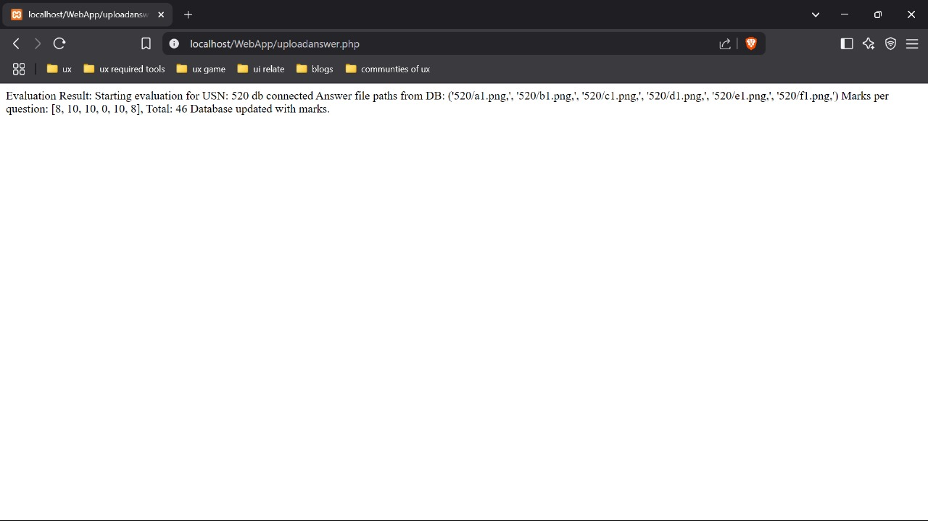
Results

Slide 16
Conclusion
This AI-based educational evaluation system enhances the assessment landscape by integrating automation, contextual understanding, and security.
With real-time feedback, reference-based grading, and controlled plagiarism detection, it not only reduces the burden on instructors but also encourages students to be original and proactive.

Slide 17
Future Scope
Future work will involve developing an assessment system to address automatic evaluation of formulas, programs written in different programming languages and graphs of student answers with improved performance and throughput.

Slide 18
REFERENCES
Johnson, K. (2003). The impact of grading on student motivation. Journal of Educational Research, 96(4), 211-218.
Kumar, A., Kumar, P., & Gupta, S. (2017). Automated evaluation system using NLP and OCR. International Journal of Advanced Research in Computer Science, 8(3), 533-538.
Plamondon, R., & Srihari, S. N. (2000). Online and off-line handwriting recognition: A comprehensive survey. IEEE Transactions on Pattern Analysis and Machine Intelligence, 22(1), 63-84.
Smith, R., Kumar, A., & Singh, A. (2019). Tesseract-OCR: An open-source optical character recognition engine. International Journal of Scientific Research in Computer Science and Engineering, 7(3), 1-5.

Slide 19
GitHub Link
https://github.com/vaishnavithondangi/AI-Eval-AI-Driven-Evaluation-for-Enhanced-Education-Using-Machine-Learning

